Slide 1






Slide 2




III B SC MATHEMATICS
UNLOCKING INSIGHTS INTO THE GLOBAL AIR TRANSPORTATION NETWORK WITH TABLEAU
TEAM CANDIDATE MEMBERS : 1) VEDASRI.G 2) VALARMATHI.G
UNDER THE GUIDENCE OF
A.BALAKRISHNAN ,M.Sc.,M.Phil.,B.Ed.,SET.,
Guest Lecture UG and PG & Department of Mathematics
MUTHURANGAM GOVERNMENT ARTS COLLEGE VELLORE-632002

Slide 3


CONTENT OF THE THESIS
INTRODUCTION
PROBLEM DEFINITION & DESIGN THINKING
RESULT
ADVANTAGES & DISADVANTAGES
APPLICATIONS
CONCLUTION
FUTURE SCOPE
APPENDIX

Slide 4



INTRODUCTION
1.1 OVERVIEW
A Business estimate is a document detailing howmuch youplan on charging a customer for a god or service. It breaks down costs line by line (eg. Each cost for providing drywall installation) so customers know where the totalis coming from.
Creating an estimate helps you outline the scope of a project,how much its going to cost you (in both time and money), and how much you will earn.
In short, this document estimates the time, money, materials, and labour needed to provide a good service.

Slide 5

1.2 PURPOSE
Estimate are documents that provide approximate costs for a project. Small businesses create them for potential clients so both parties are clear on the ins and outs of a project before it starts. Fresh Books has an estimates feature that help you build an estimate quickly and easily.
Ensure you understand what the projects involves
Help you deceide whether to take on the project
Determine if you have enough cash

Slide 6

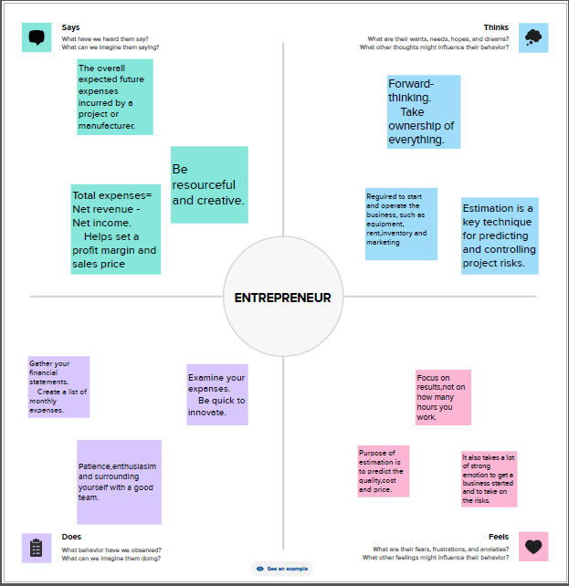
PROBLEM DEFINITION & DESIGN THINKING
2.1 EMPATHY MAP

Slide 7

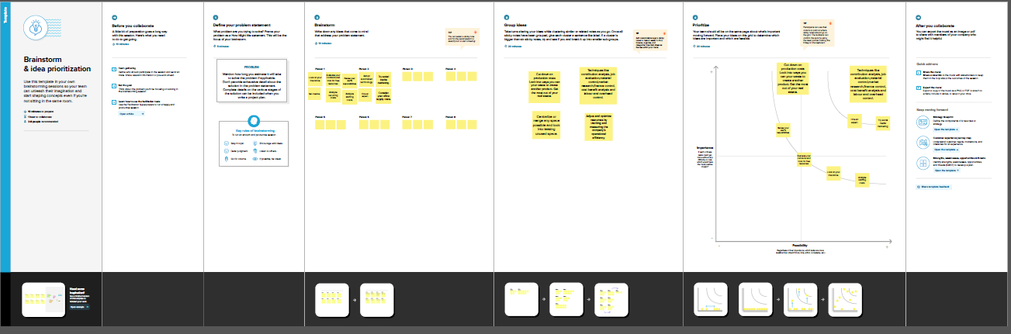
2.2 IDEATION & BRAINSTORMING MAP

Slide 8

ADVANTAGES & DISADVANTAGES
ADVANTAGES OF ESTIMATION OF BUSINESS EXPENSES:
Build stronger client relationships.
Work simple.
Be flexible.
DISADVANTAGES OF ESTIMATION OF BUSINESS EXPENSES:
New estimates must be bulit for each alternative
The product specifications must be well-know and stable
It can be expensive to implement and it is time consuming.

Slide 9
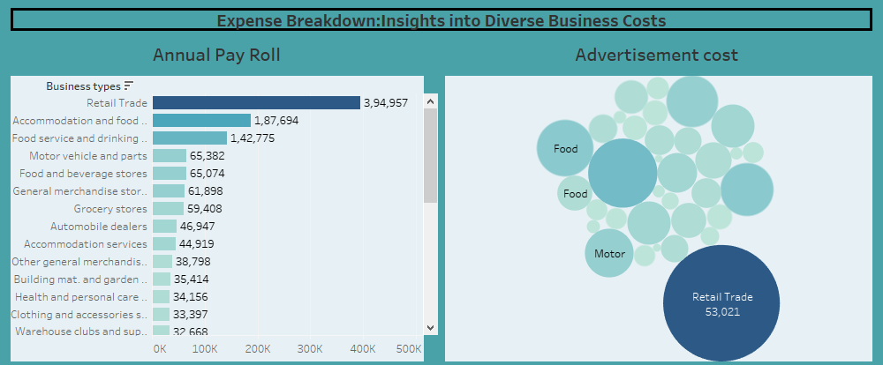
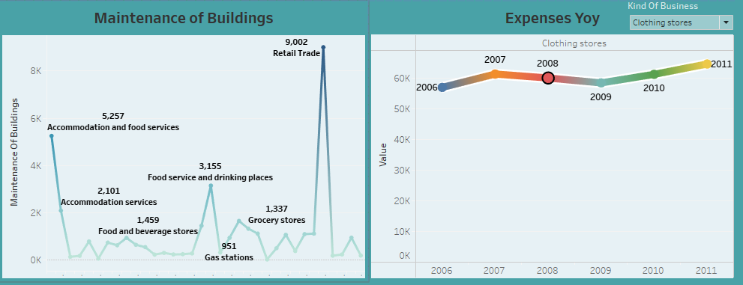
RESULT
DASHBOARD 1

Slide 10
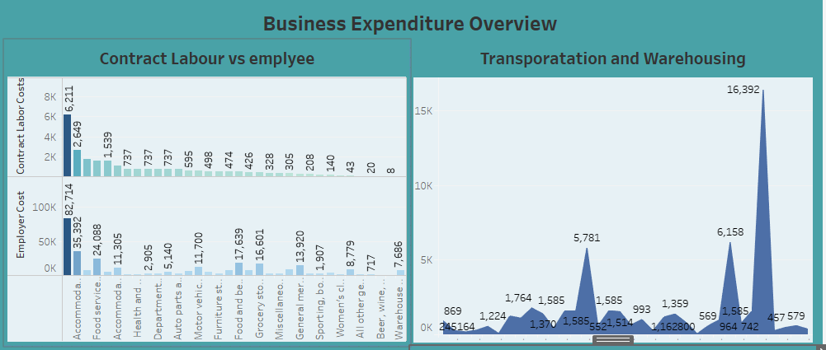
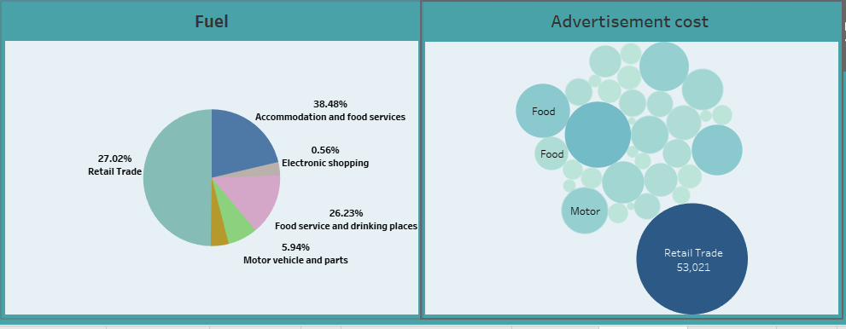
DASHBOARD 2

Slide 11
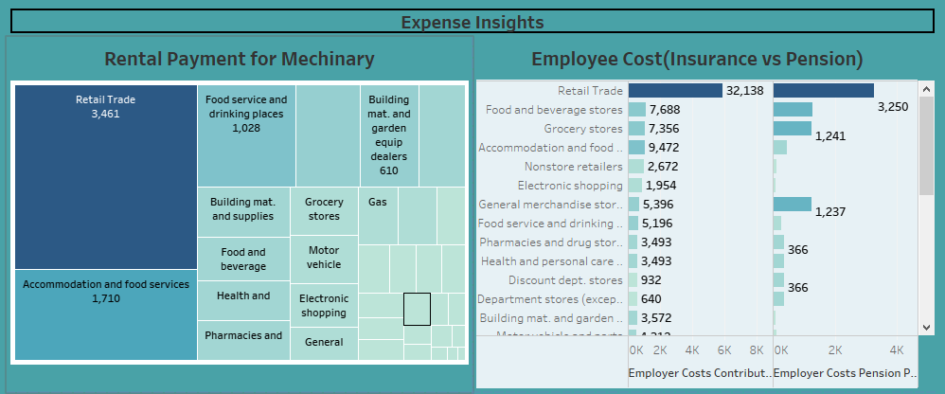
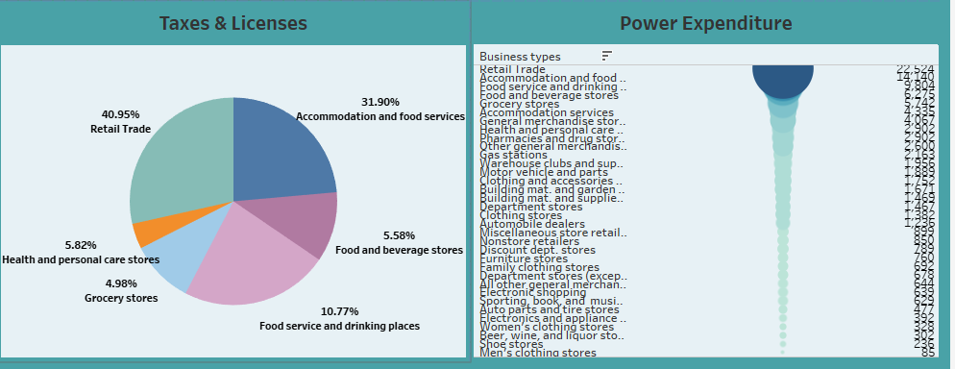
DASHBOARD 3

Slide 12
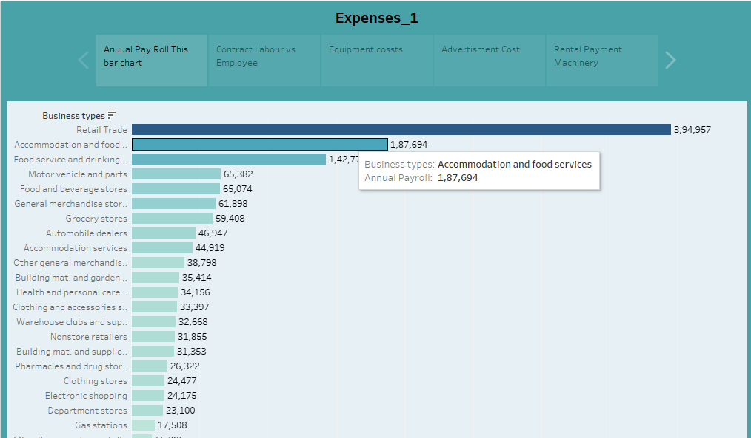
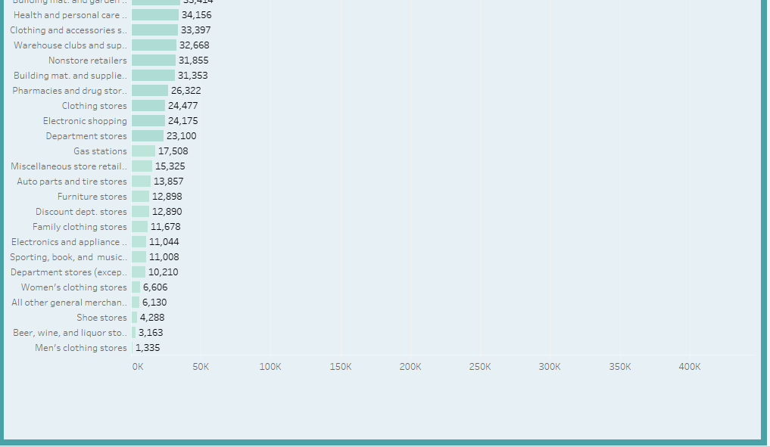
STORY 1.1

Slide 13
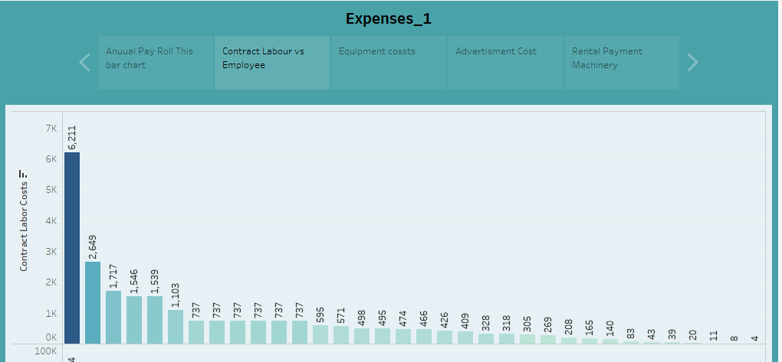
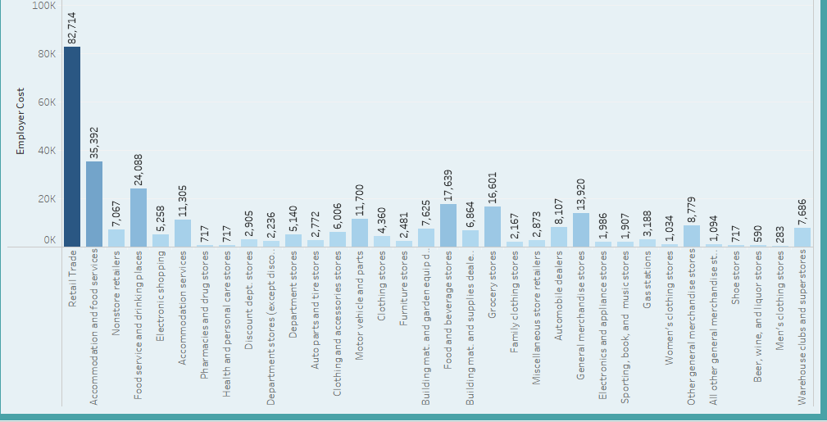
STORY 1.2

Slide 14
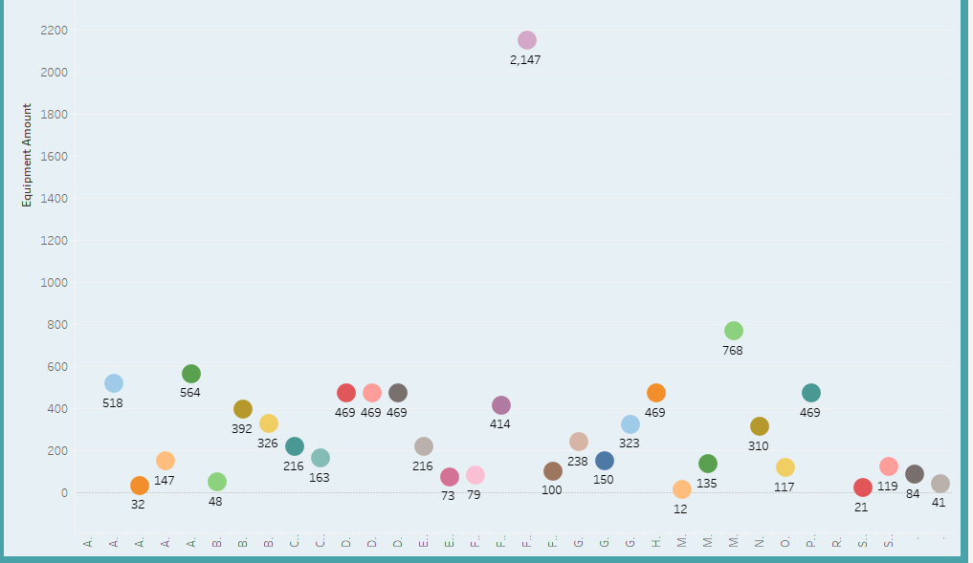
STORY 1.3

Slide 15
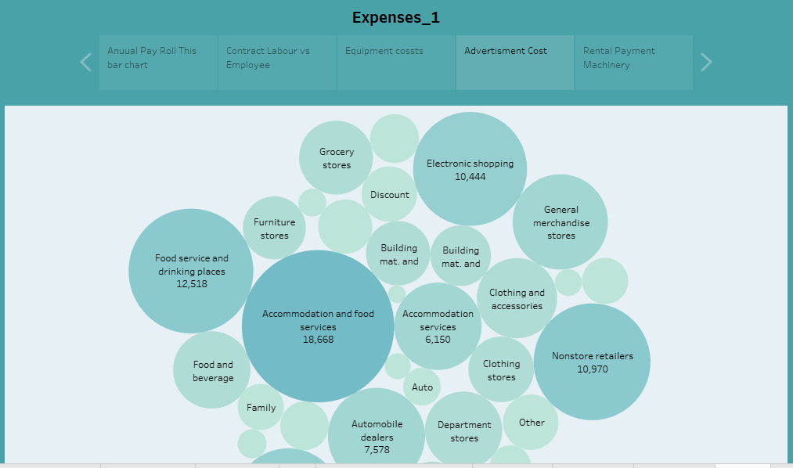
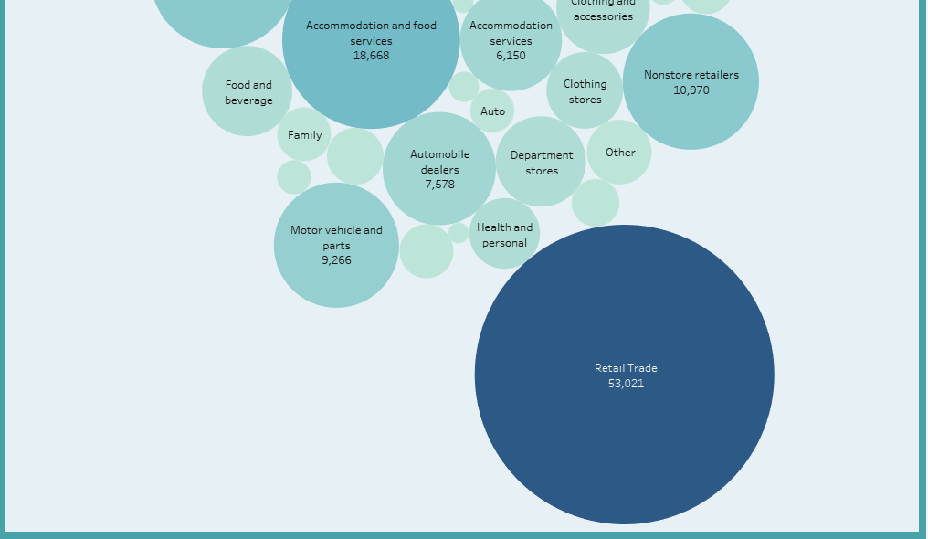
STORY 1.4

Slide 16
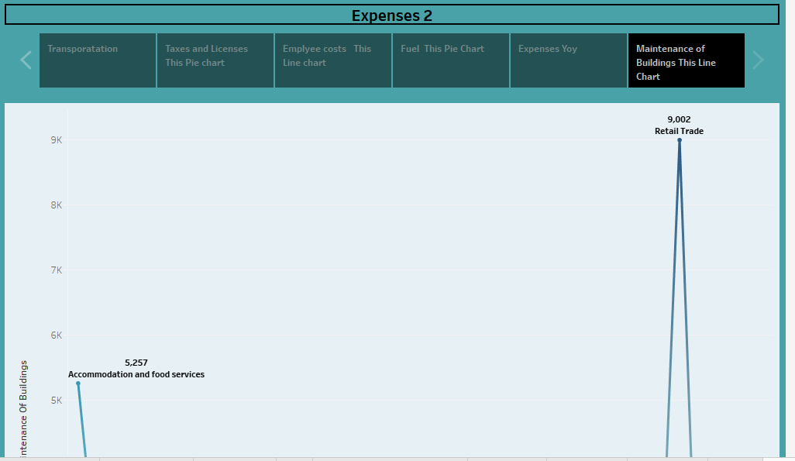
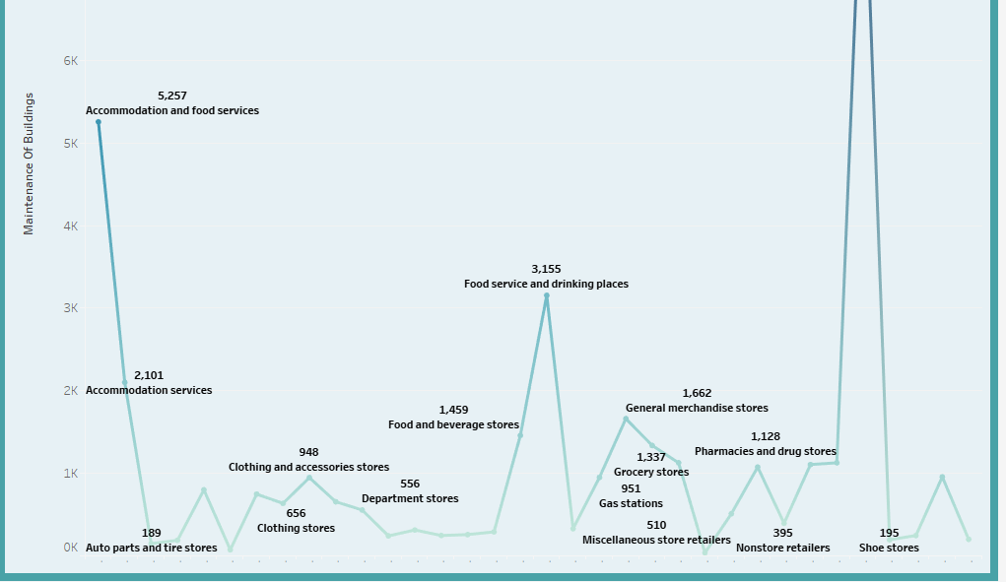
STORY 2.1

Slide 17
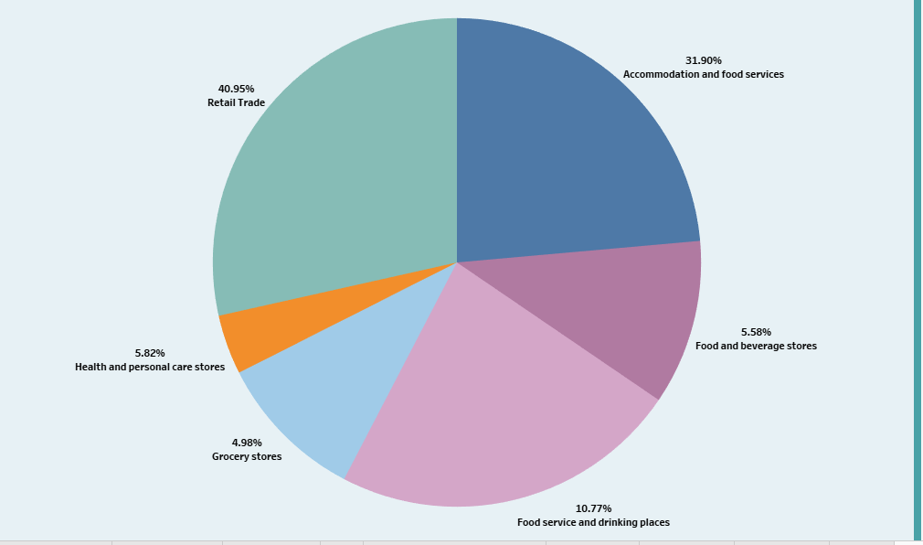
STORY 2.2

Slide 18
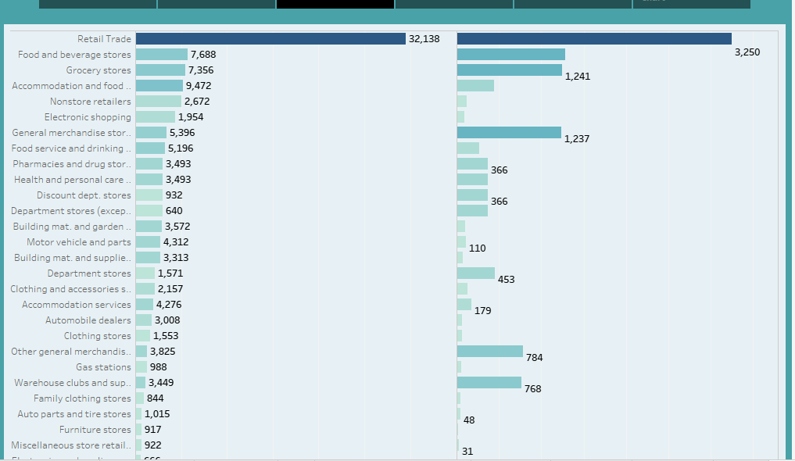
STORY 2.3

Slide 19
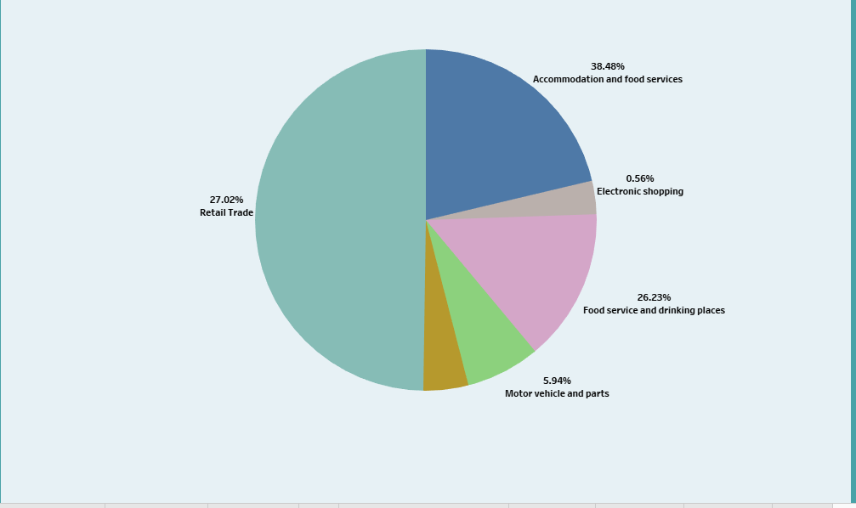
STORY 2.4

Slide 20
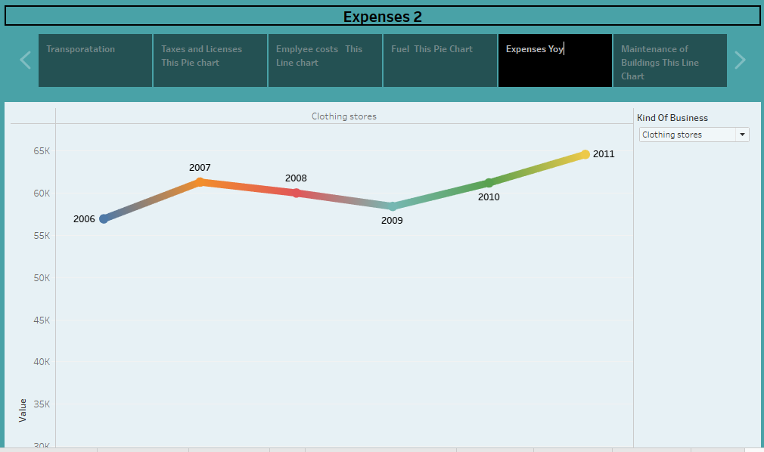
STORY 2.5

Slide 21
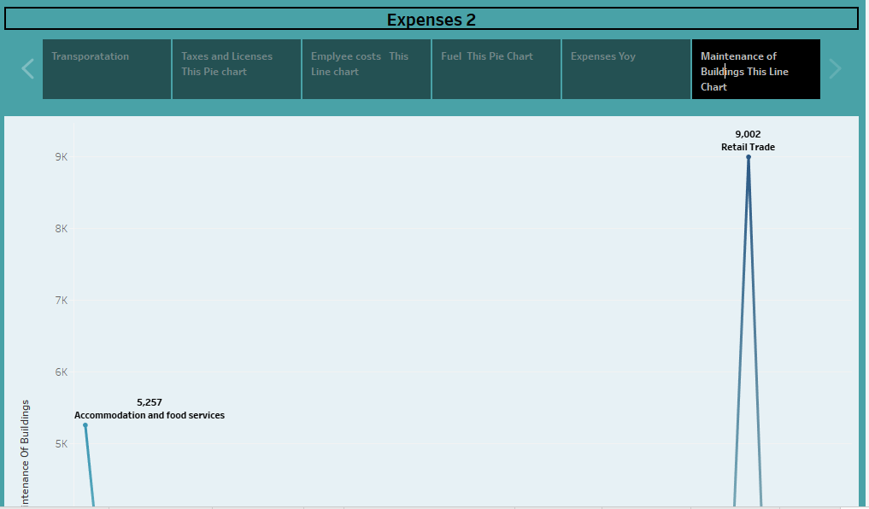
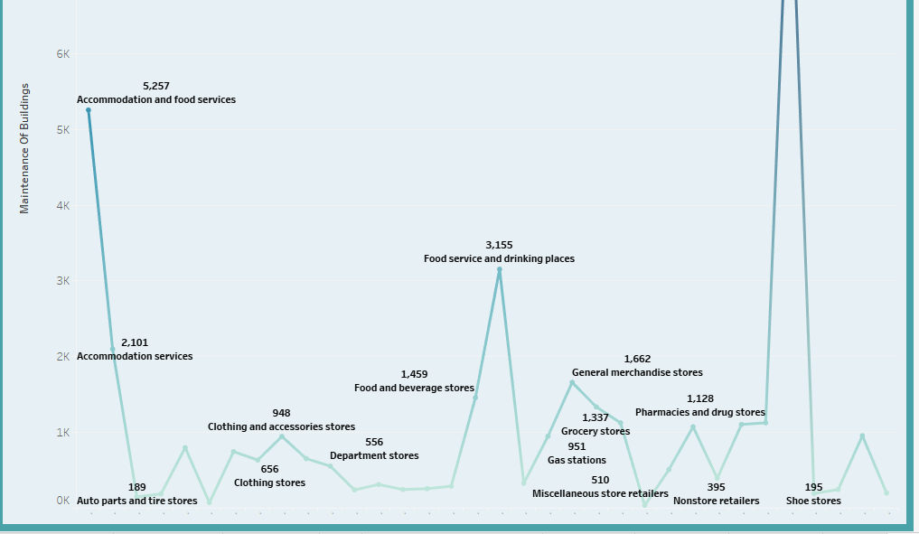
STORY 2.6

Slide 22


APPLICATIONS
Location costs
Utilities
Telephone and internet
Business insurance
Office equipment
Employee salary and benefits
Marketing expenses
Taxes
Business fees
Business meals
Employee gifts

Slide 23


CONCLUSION
❖ The Global Air Transportation Network plays a multifaceted and indispensable role in our
interconnected world.
❖ It supports economic growth, facilitates global trade, and serves as a lifeline for emergency responses and humanitarian efforts, while also promoting cultural
exchange and international collaboration through travel
and tourism.
Cost estimation is an important component of project management that ensures project management that ensures project are finished on schedule and within budget. Since inaccurate cost estimates can have serious financial consequences for business, accurate cost estimating is crucial for all stakeholders engaged in a project.

Slide 24


FUTURE SCOPE
Cost estimation in project management is the process of forecasting the financial and other resources needed to complete a project within a defined scope. Cost estimation accounts for each element required for the project from materials to labour and calculates a total amount that determines a project’s budget.

Slide 25



